Slide 1

EVOLUTION OF MICRO-PROCESSORS
©️ TEAM FANATIC4 Diploma 6th sem CSE CITK

Slide 2
SEMINAR OVERVIEW
01
01
INTRODUCTION
02
MARKET MONOPOLY
A short overview of the microprocessors
Monopoly of Intel and Amd and availability of architectures
03
EVOLUTION OF SOC
04
CONCLUSION
In-Depth go through of the Evolution of Microprocessor
The rise of mobile soc and India’s Shakti microprocessor

Slide 3
ABSTRACT
Microprocessor has turned into the brain of millions of gadgets, since year 1971 i.e., devoid of microprocessors these wonderful innovations of millions of gadgets would have not been possible. The microprocessor has many functions like functions of data storage, interact with various other devices, and other time-related functions. But, the main function is to send and receive the data to make the function of the computer well. In this seminar we will discusses the types and evolution of microprocessor.

Slide 4
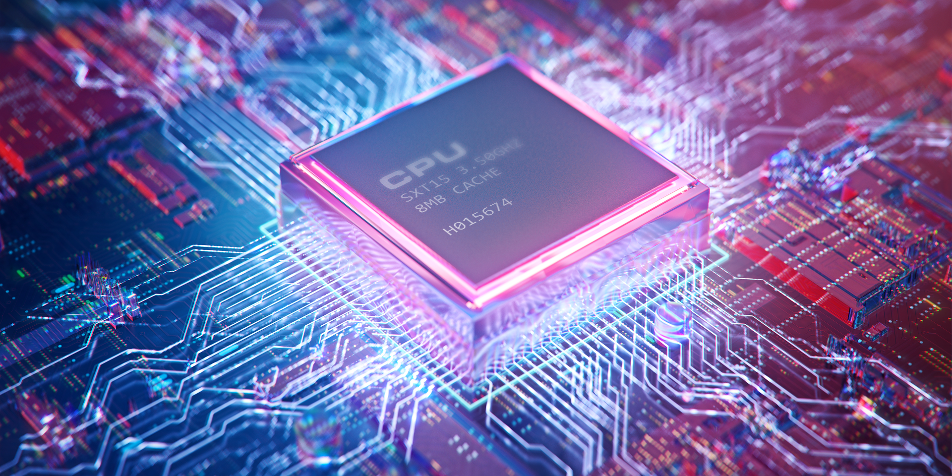
INTRODUCTION TO MICROPROCESSOR

Slide 5
WHAT IS A MICROPROCESSOR
A microprocessor is the most important unit within a computer system and is responsible for processing the unique set of instructions and processes. A microprocessor is designed to execute logical and computational tasks with typical operations such as addition/subtraction, interprocess and device communication, input/output management, etc.

Slide 6
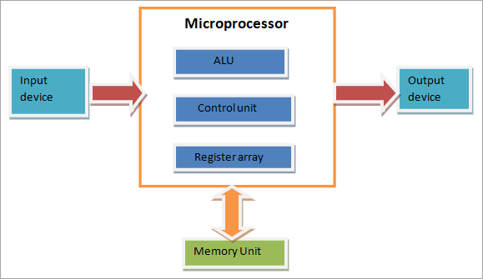
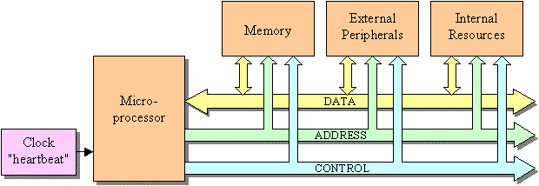
Working principle and basic architecture of processors
- BASIC ARCHITECHURE OF
MICROPROCESSORS
Working principle of
motherboards -

Slide 7
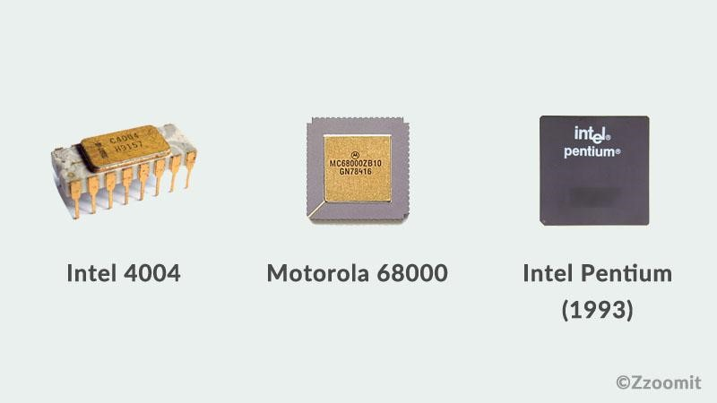
Evolution of Microprocessors
1st Generation - Intel 4004, 4040
2nd Generation - 8008, 8085 16bit
3rd Generation - 8088, 80186 24bit
4th Generation - 80386, Pentium x86
5th Generation – Amd Athlon, Intel Core

Slide 8
Monopoly of Companies

Slide 9
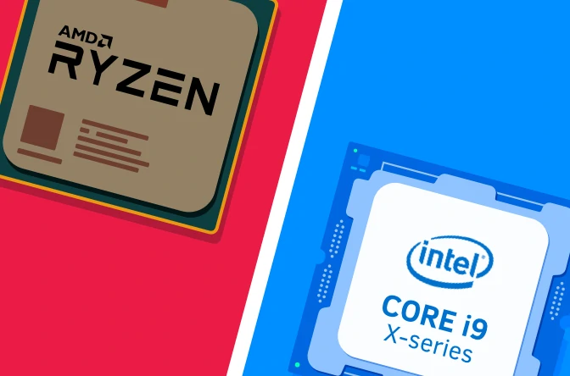
Monopoly of Intel and Amd:
We'll take a look at the history of competition between Intel and AMD and try to explain why AMD has been, and remains, Intel's only real competitor. Intel was co-founded in mid-1968 by Gordon Moore, known for formulating Moore's Law, and by Robert Noyce, who helped invent the silicon integrated circuit. Both men were former employees of Fairchild Semiconductor, an early and influential pioneer in integrated circuit technology. AMD was founded a few months later in 1969, also by former employees of Fairchild Semiconductor. The two companies
have, therefore, a shared lineage and similar origins.

Slide 10
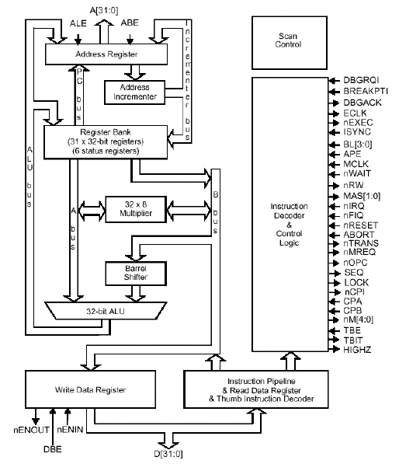
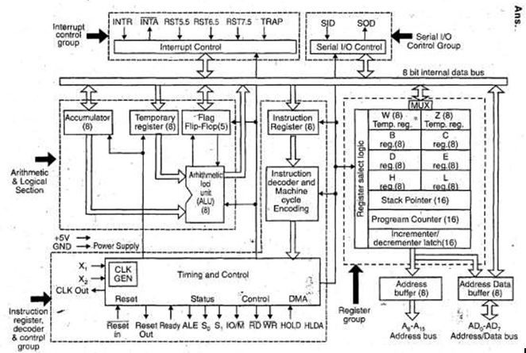
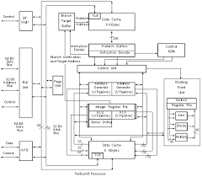
Availability of architectures
Even after 50 years of the initial release of x86 chipsets, till date one can only get their hands on a very few selected complete/raw architectures of intel’s microprocessors:

Slide 11
Forgotten history of Amd
In February 1982, AMD signed a contract with Intel, becoming a licensed second-source manufacturer of 8086 and 8088 processors. IBM wanted to use the Intel 8088 in its IBM PC, but IBM's policy at the time was to require at least two sources for its chips. AMD later produced the Am286 under the same arrangement, but Intel canceled the agreement in 1986 and refused to convey technical details of the i386 part. AMD challenged Intel's decision to cancel the agreement and won in arbitration, but Intel disputed this decision. A long legal dispute followed, ending in 1994 when the Supreme Court of California sided with AMD. Subsequent legal disputes centered on whether AMD had legal rights to use derivatives of Intel's microcode. In the face of uncertainty, AMD was forced to develop clean room designed versions of Intel code.

Slide 12
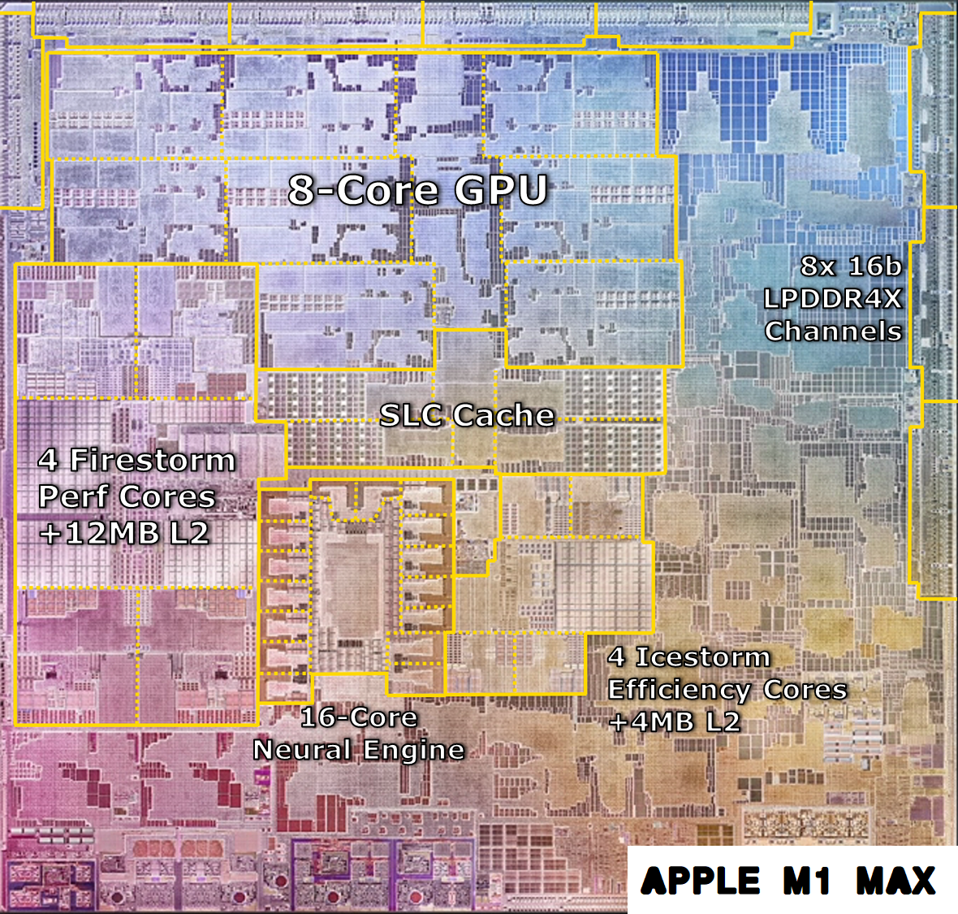
Current market situation
We can say finally after so many years, any company succeeded to make a processor that actually gives a toe to toe competition to Intel and Amd’s consumer grade CPUs, We are talking about none other than Apple’s M1 chip, when apple launched their m1 chipset on 2020, no one expected that a Arm based chip will give some tough time to intel and amd’s x64 chipsets.

Slide 13
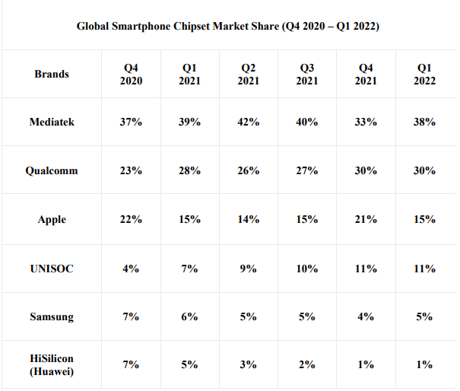
The rise of mobile SOCs
In 2022 it is wrong to say that Intel and Amd still dominated all the microprocessors market because the mobile and notebook’s soc scene has been different lately. There’s plenty of big names in market like Samsung’s Exynos, MediaTek and etc. but the majority of the time the market is ruled by Qualcomm’s Snapdragon mobile processors series, almost all the chipsets on the market are based on Arm architecture and shares similar working architecture.

Slide 14
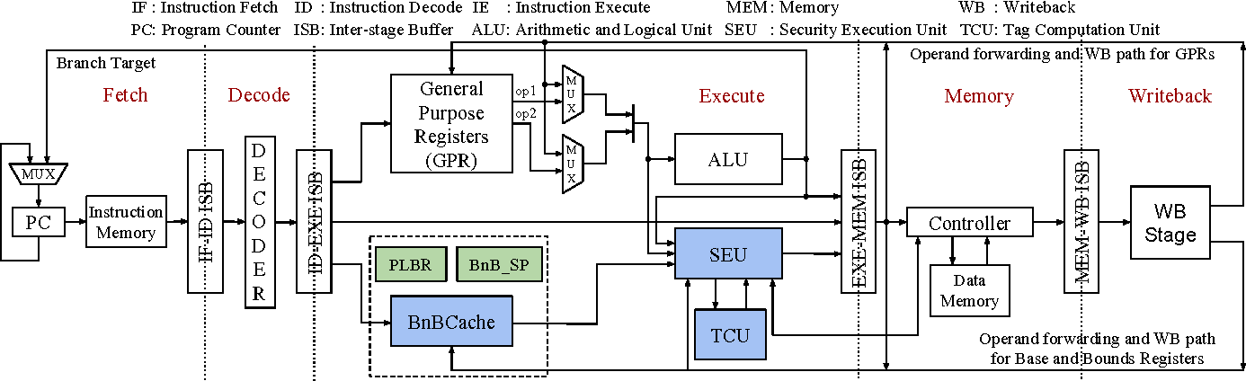
India’s contributions in microprocessors industry
In past there’s been many attempts to manufacture our very own made in India microprocessor but one name made it to the headlines i.e. SHAKTI – it is an open-source initiative by the Reconfigurable Intelligent Systems Engineering (RISE) group at Indian Institute of Technology, Madras to develop the first indigenous Indian industrial-grade processor.

Slide 15
Conclusion
We have come a long way from the first computer by IBM to the present power house that fits perfectly in our pocket. This was a small seminar and hopefully we got able to keep you interested on the topic till now, So this is all for now, we did whatever was possible for us in just two days because we got informed about this seminar only a day before so we will do whatever changes is asked by any of you teachers to make it reach your expectations and our academic goals.

Slide 16
REFERENCES
Main Guide: https://www.bharatacharyaeducation.com/index.php/channel/index
Reference Article: https://www.javatpoint.com/microprocessor-introduction
Reference Article: https://www.techopedia.com/definition/2874/microprocessor
Article on evolution of mup: https://www.geeksforgeeks.org/evolution-of-microprocessors/
Article on History of mup: https://www.tutorialspoint.com/history-of-microprocessor
Wiki page of mup: https://en.wikipedia.org/wiki/Microprocessor_chronology
About intel and amd: https://www.youtube.com/watch?v=KGMABnrgwRU
Article about monopoly of intel: https://investorplace.com/2016/04/intel-intc-a-technology-monopoly-paying-safe-growing-dividends/
about monopoly of intel and amd: https://www.youtube.com/watch?v=1EEakkh4ZG4
Article about monopoly in soc market: https://www.investopedia.com/insights/why-amd-intels-only-competitor-intc-amd/
Video about market status: https://www.youtube.com/watch?v=8i67R5bnb14
History of amd: https://www.youtube.com/watch?v=K8Lz3ANjlDs
Mup market analysis: https://www.grandviewresearch.com/industry-analysis/microprocessor-market
Outcomes of this monopoly: https://www.youtube.com/watch?v=0SyLqFuf_SU
Amd and intel’s fake competition: https://www.extremetech.com/computing/335650-amd-achieves-all-time-record-x86-market-share-in-q1-2022
All about arm cpu: https://www.youtube.com/watch?v=X4BxUiqWq8E
Other soc manufacturers: https://www.techspot.com/article/2271-the-other-cpu-makers/
Article on mobile soc market: https://www.counterpointresearch.com/global-smartphone-ap-market-share/
Wiki page of m1 chip: https://en.wikipedia.org/wiki/Apple_M1
Future of mobile soc market: https://www.youtube.com/watch?v=lFPnY39Ob_c
A make in india SOC: https://shakti.org.in
Wiki page of SHAKTI mup: https://en.wikipedia.org/wiki/SHAKTI_(microprocessor)
Shakti cpu’s performance: https://www.youtube.com/watch?v=EylVBCGWWD0
Nvidia’s plan to enter cpu market: https://www.youtube.com/watch?v=v0FByWRgjXI

Slide 17
THANK YOU
Thanks Teacher and all respected panel members, that was all from us team fanatic four Diploma 6th semester Computer Science Dept. hope you liked 🙏
https://github.com/FalconEthics
©️ TEAM FANATIC 4 - 2022

